Slide 1
Java Persistence

Slide 2
Agenda
JPQL
Architectuur

Slide 3
JPQL

Slide 4
Syntax
JPQL lijkt veel op SQL
Select op Entiteiten ipv tabellen
ook COUNT, DISTINCT, LIKE, IN …
Syntax:
SELECT a FROM Account a
WHERE a.balance < 0;
SELECT o.city
FROM Account a JOIN a.owner o;

Slide 5
Queries
Dynamic queries
Named queries
Native queries
Criteria API

Slide 6
Named Queries 1
Definitie
@NamedQuery(
name = "Account.findByAccountNr",
query = "select a from Account as a
where a.accountNr = :accountNr")
public class Account {
Executie
Query q = em.createNamedQuery("Account.findByAccountNr", Account.class);
q.setParameter("accountNr", accountNr);
Account a = (Account) q.getSingleResult();

Slide 7
Named Queries 2
Definitie
@NamedQuery(name = "Account.getAll",
query = "select a from Account as a")
public class Account {
Executie
Query q = em.createNamedQuery("Account.findAll", Account.class);
List<Account> al = q.getResultList();

Slide 8
Layered architecure
Software is often constructed in layers.
A lower layer offers services to the layer just above it.
If the layers run on different hardware, they are often called tiers.
Example 2-tier architecture: client-server,
front-office/back-office.

Slide 9
Possible implementation
The business tier works with objects (no SQL)
The data tier provides data access objects (DAO’s) that have methods to store and retrieve information into and from a relational database. In the implementation of these methods SQL is used.

Slide 10
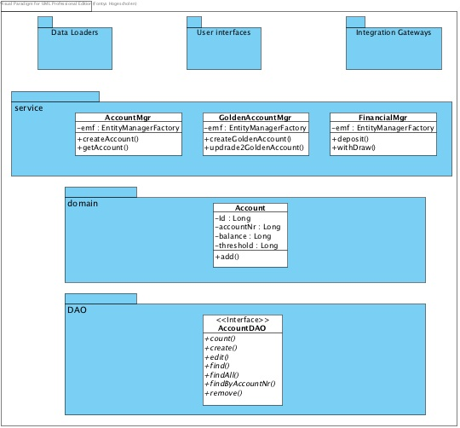
Architecture
Application boundary
Application facade
Transaction control
Business layer
Data layer
Technical service

